Slide 1
Team 6:
The Jython Project
MH Johnson
Henry Noonan

Slide 2
Topics of Discussion
What we made.
Decisions we made.
What we learned.
What we would change.

Slide 3
What we made
Testing Framework in Python
Interprets and executes textual use cases
Can test any standalone function within a python module
Displays the test case results in an html file
Initially built with the Jython framework in mind, but is extensible.
As long as test cases and project path are provided

Slide 4

What is Jython?
Jython is an open source project that implements the python programming language such that it can run on the java virtual machine.
Notes:
While our framework is extensible to any python project, we built our framework with the jython project in mind.

Slide 5
Decisions We Made
Codebase to Test:
Jython
Specifically Python Libraries within the Jython Framework
Scripting Language:
Python
Test Case Format:
Text files

Slide 6
Why Test Jython?
Open source
High quality documentation
Strong community of users and Developers
Portability
Notes:
While our framework is extensible to any python project, we built our framework with the jython project in mind.

Slide 7
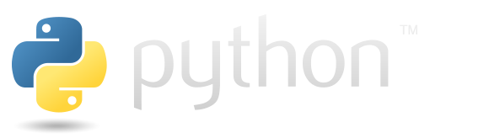
Why Script in Python?
Easy to read code
Convenient for interacting with jython codebase (specifically python code)
Able to execute bash commands within the python code using the subprocess library

Slide 8
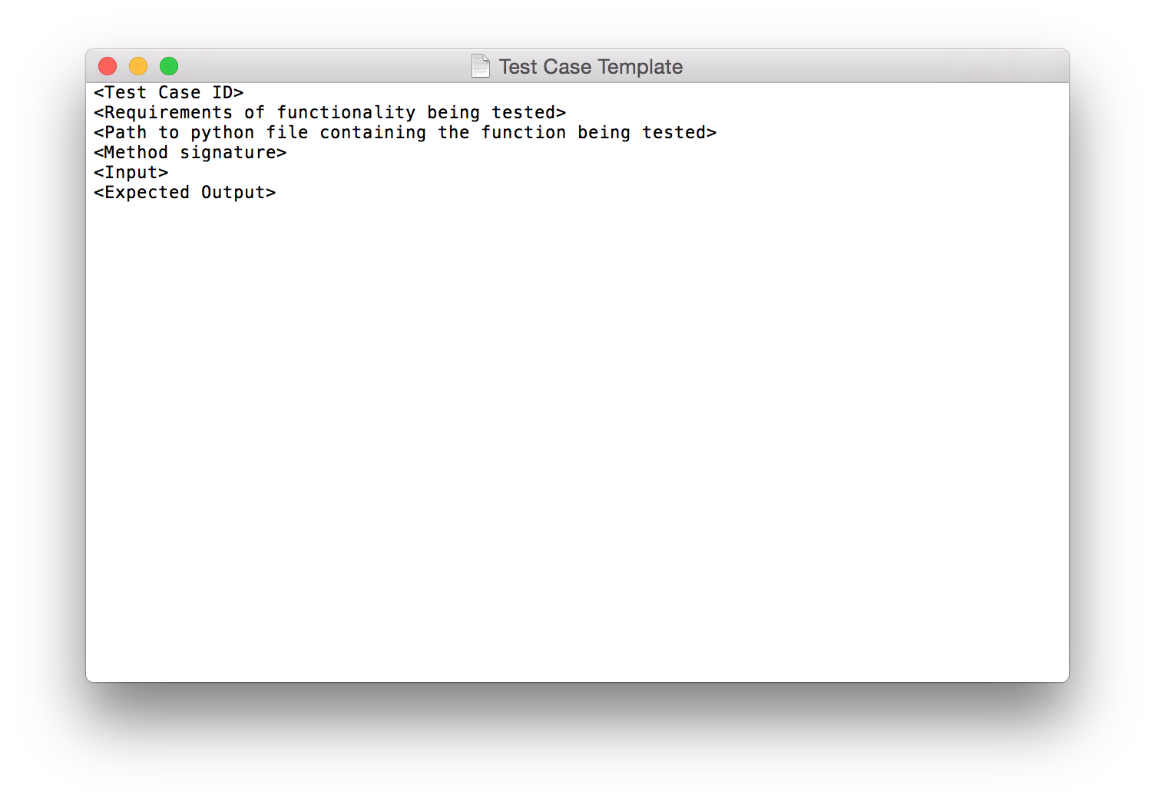
Why put test cases in text files?
Separates test case execution from test case creation
Allows user to focus on test case exclusively
Test Case Template:

Slide 9
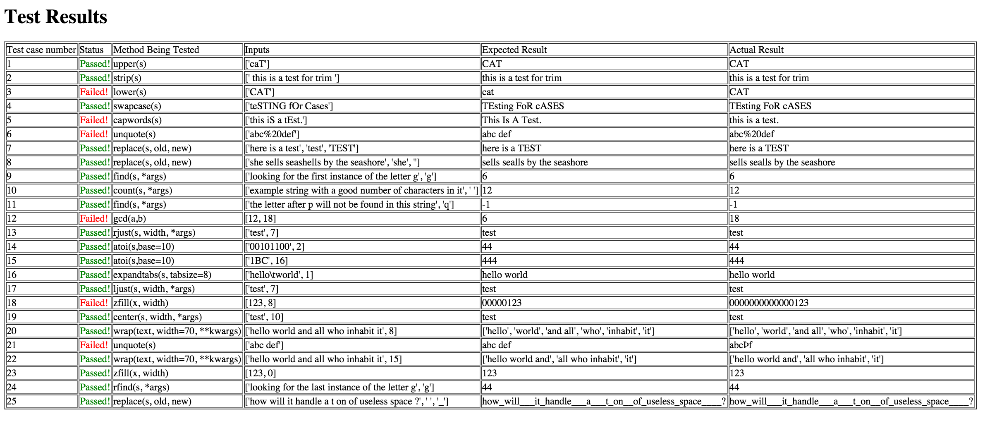
Sample Results

Slide 10
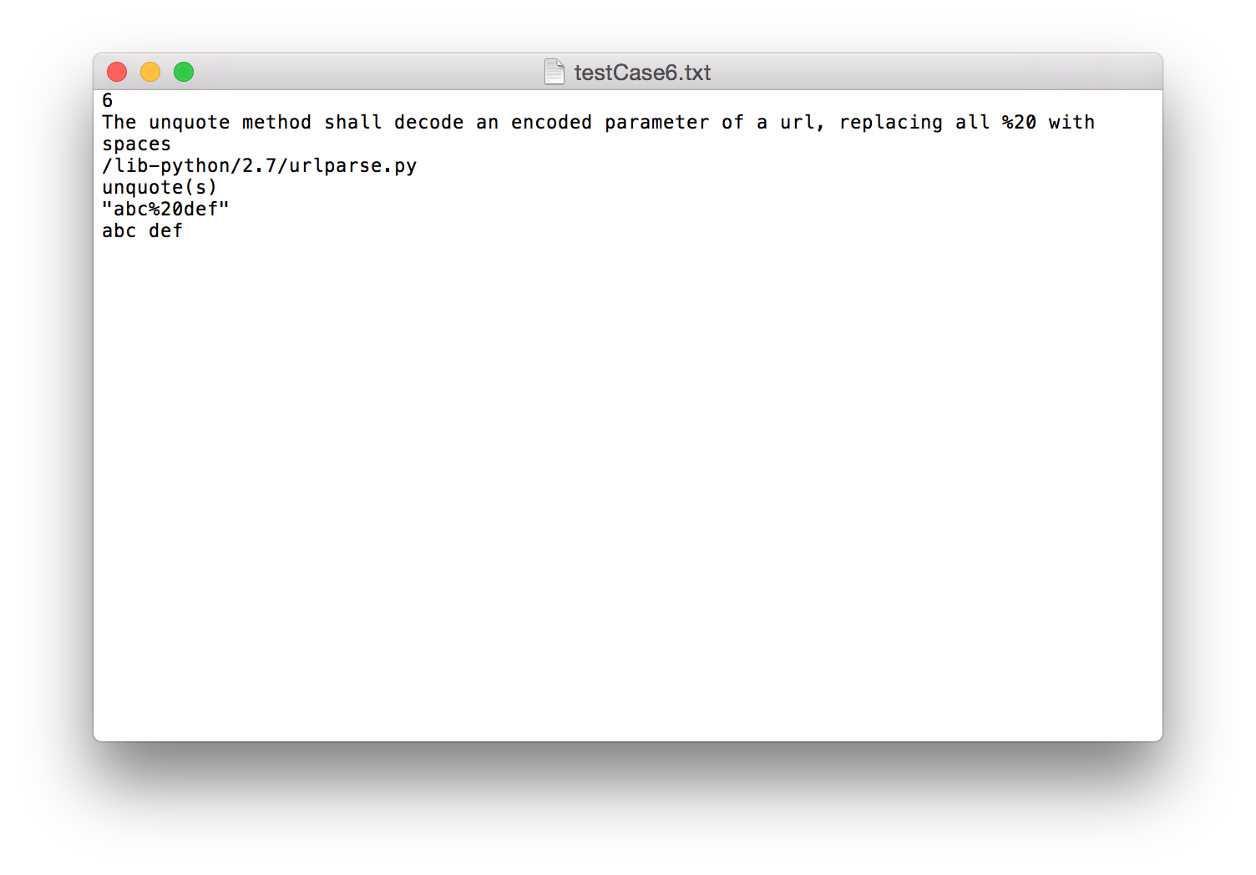
Example Test Case

Slide 11
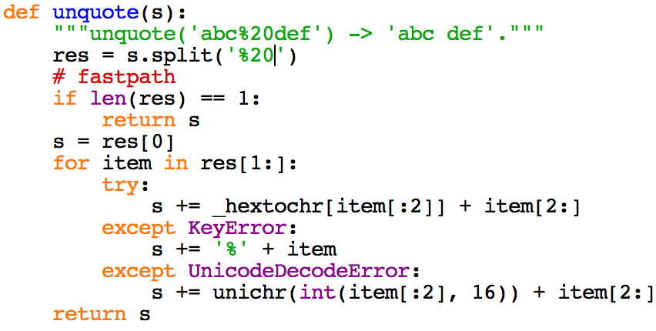
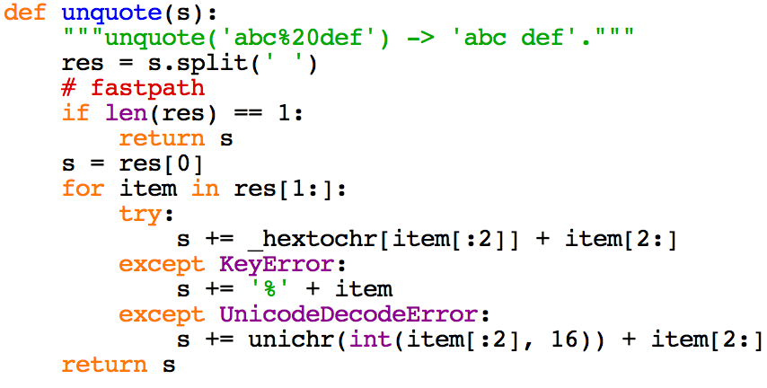
Sample Fault Injection

Slide 12
Fault Injection Result

Slide 13
What we learned throughout the process
Deliverable #1 (Build and Test)
How to install ubuntu on a virtual machine.
How to download and build an open source framework.
Mercurial version control

Slide 14
What we learned throughout the process
Deliverable #2 (5 Test Cases)
How to use Git/github
How to navigate codebase
Selecting modules to test
Eventually chose python libraries
Figuring out how to have a script navigate a file system and import/call python functions given only textual input at runtime
Notes:
ii. we eventually settled on testing python libraries, because their functionality was very clearly established AND standalone. Since the creation of these libraries, a lot of the functionality has been built into default python, but it is still important to test because code written long ago still uses these methods.

Slide 15
What we learned throughout the process
Deliverable #4 (25 Test Cases)
Had to expand framework to handle more than just string in -> string out methods
Determining conventions for how to handle:
Multiple inputs
Different input data types
About ~ files in ubuntu

Slide 16
What we learned throughout the process
Deliverable #5 (Fault Injection)
About the python import search path
How to tell python where to look for modules being imported

Slide 17
What we would change
Given more time:
Extend functionality to be able to test not just python functions, but class level methods
Extend functionality to be able to handle different types of inputs/outputs ( tuples, lists, mock objects etc.)
Add flexibility to root directory location of test codebase (right now user has to explicitly state filepath)
Execute the test cases sequentially to avoid storing multiple test cases in memory simultaneously

Slide 18
Thank you.
Questions?

